Slide 1
TAP into async programming
Chris Dahlberg

Slide 2
Platinum Sponsors
Gold Sponsors
Silver Sponsors

Slide 3
Threading Models
Single-Threaded
Explicit Thread Management
Thread Pool
Asynchronous Programming Model (APM)
Event-Based Asynchronous Pattern (EAP)
Task-Based Asynchronous Pattern (TAP)
Async/Await

Slide 4
Single-Threaded
Simplest
Available in all .NET versions

Slide 5
Explicit Thread Management
Varying complexity
Available in all .NET versions

Slide 6
Thread Pool
Simple
Available in all .NET versions

Slide 7
Event-Based Asynchronous Pattern
Not simple
Available in .NET 2.0 and newer

Slide 8
Asynchronous Programming Model
Not simple
Available in .NET 2.0 and newer

Slide 9
Task-Based Asynchronous Pattern (TAP)
Simple
Available in .NET 4.0 and newer

Slide 10
Async/Await
Simple
Available in .NET 4.5 and newer

Slide 11
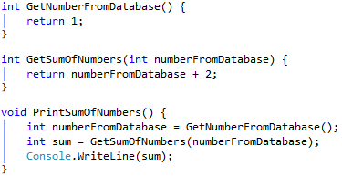
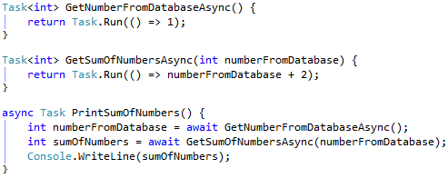
Why Use Async/Await?
Simplicity
Can be nearly as simple as single-threaded code
Single-Threaded:
Async/Await:

Slide 12
Why Use Async/Await? (cont’d)
Performance
Run IO-bound code asynchronously
Avoid blocking GUI threads
Use IIS worker threads more efficiently
Run CPU-bound code in parallel
More efficiently use all available CPU cores

Slide 13
WCF Service Performance Example
Server
Azure VM, Single CPU
Client
Laptop with Core i7 CPU
150 requesting threads
GetCurrentTimeSlow
IIS reached 118 threads
468 requests per second
GetCurrentTimeAsync
IIS stayed at 20 threads
480 requests per second

Slide 14
Parallel Performance Example
Run on a 4-core CPU
GetNumber
1.83 seconds
GetNumberAsync
0.55 seconds

Slide 15
How Async/Await Works
If a Task is completed when awaited, await runs synchronously
If a Task is not yet completed when awaited:
ExecutionContext (including SynchronizationContext) is saved
The thread of the calling method can be used to run other code
Once the awaited task completes, the method that called await continues executing using the saved ExecutionContext
ASP.NET, WPF, etc. each have their own special contexts
When SynchronizationContext is null, the calling method continues on the ThreadPool context

Slide 16
Basic Things to Know
Await can only be used in methods marked with the async modifier
Async methods must have a return type of Task, Task<T>, or void
For methods that do not return a value, use Task
For methods that return a value, use Task<T>
Do not use void
Async method names should have an “Async” suffix
Sync: string GetName()
Async: Task<string> GetNameAsync()
Tasks returned by async methods should already be started

Slide 17
Where to Use Async/Await
Ideally, use async code pervasively
“Grows like a virus” from entry point to API
If necessary, use async code which…
…calls other threading models
…is called by other threading models

Slide 18
Common Async Entry Points
Event handlers
Windows Forms
Windows Presentation Foundation
Service operations
Windows Communication Foundation
WebAPI

Slide 19
Event Handler Example
The only situation where async void methods should be used
Event handlers typically do not include an “Async” suffix

Slide 20
Service Operation Example
Methods in contracts should include the Async suffix
The Async suffix will not be included in WSDL or visible to clients
Worker threads can be freed and handle additional requests

Slide 21
Common Async APIs
Service clients
Streams
Database clients
Entity Framework
Networking clients

Slide 22
Async Service Client APIs
Svcutil.exe can generate Async variants of methods

Slide 23
Async Stream APIs
Stream methods
ReadAsync(byte[], int, int)
WriteAsync(byte[], int, int)
StreamReader methods
ReadBlockAsync(char[], int, int)
ReadLineAsync()
ReadToEndAsync()
StreamWriter methods
WriteAsync(string)
WriteLineAsync(string)

Slide 24
Async Database APIs
DbConnection methods
OpenAsync()
DbCommand methods
ExecuteNonQueryAsync()
ExecuteReaderAsync()
ExecuteScalarAsync()
DbDataReader methods
ReadAsync()
NextResultAsync()

Slide 25
Async Entity Framework APIs
DbSet<T> methods
FindAsync
IQueryable<T> methods
AllAsync, AnyAsync
AverageAsync, SumAsync
ContainsAsync
CountAsync, LongCountAsync
FirstAsync, FirstOrDefaultAsync
MaxAsync, MinAsync
SingleAsync, SingleOrDefaultAsync
ToArrayAsync, ToDictionaryAsync, ToListAsync

Slide 26
Async Networking Client Methods
TcpClient methods
ConnectAsync
UdpClient methods
ReceiveAsync
SendAsync

Slide 27
Calling Other Threading Models
Event-Based Asynchronous Pattern (EAP)
Asynchronous Programming Model (APM)

Slide 28
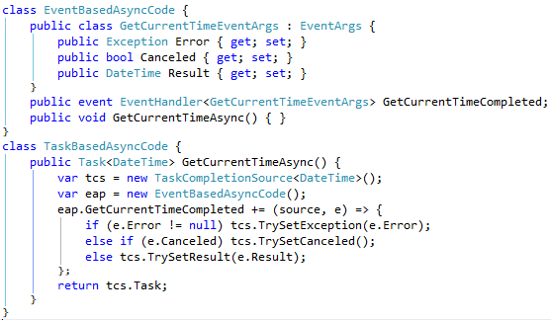
Calling Event-Based Asynchronous Pattern

Slide 29
Calling Asynchronous Programming Model

Slide 30
Called By Other Threading Models
Event-Based Asynchronous Pattern (EAP)
Asynchronous Programming Model (APM)
Single-threaded code

Slide 31
Called By Event-Based Asynchronous Pattern

Slide 32
Called By Asynchronous Programming Model

Slide 33
Called By Single-Threaded Code
Don’t do it
Ok, if you must do it, use Task.Run
var result = Task.Run(() => DoSomethingAsync()).Result;

Slide 34
Best Practices
Do not create async methods that contain only CPU-bound code
Do not use Task.Run to create an async wrapper method around CPU-bound code
Do not use async void methods except for event handlers
Exceptions thrown from async void method can not be caught in a try/catch block.
Tasks do not need to be disposed unless the AsyncWaitHandle property is accessed
Always use .ConfigureAwait(false) in library code

Slide 35
Pitfalls
Deadlocks
Exceptions wrapped in AggregateException
Thread synchronization limitations
Entity Framework limitations
IIS request limits

Slide 36
Deadlocks
Multiple tasks waiting for the same SynchronizationContext
To avoid, use .ConfigureAwait(false) whenever possible
Non-async code waiting on an async Task
To avoid, use Task.Run to run async code from non-async code

Slide 37
Exceptions Wrapped in AggregateException
When calling .Wait() or .Result, exceptions are wrapped in an AggregateException
Can use .GetAwaiter().GetResult(), which will throw the actual exception
Can catch AggregateException and manually get the actual exception
AggregateException.Flatten().InnerExceptions.First()

Slide 38
Thread Synchronization Limitations
await can not be used…
…within lock blocks
…between Monitor.Enter and Monitor.Exit
…between Mutex.WaitOne and Mutex.ReleaseMutex

Slide 39
Entity Framework Limitations
Unable to have multiple simultaneous async operations Must use multiple DbContexts

Slide 40
IIS Request Limits
On most non-server versions of Windows, IIS limits the number of concurrent requests to 10

Slide 41
Tips and Tricks
Custom thread synchronization
Task dependencies
AsyncLazy
Caching tasks
TaskCompletionSource

Slide 42
Custom Thread Synchronization
Could create your own using a combination of lock statements, ConcurrentQueues, Interlocked.CompareExchange, and TaskCompletionSources
Could use an AsyncLock implementation that is already available from NuGet
Nito.AsyncEx (by Stephen Cleary)
https://www.nuget.org/packages/Nito.AsyncEx/
13,987 downloads of the latest version
CodeTiger.Core (by me)
https://www.nuget.org/packages/CodeTiger.Core/
55 downloads of the latest version

Slide 43
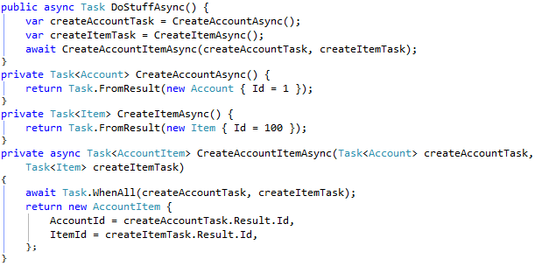
Task Dependencies
Pass Task and Task<T> objects into other async methods

Slide 44
AsyncLazy
Comparable to Lazy<Task<T>>
Lazy<Task<T>: AsyncLazy<T>:

Slide 45
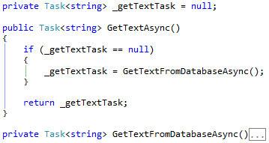
Caching Tasks
Cache completed tasks to return from Async methods

Slide 46
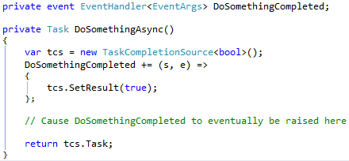
TaskCompletionSource
Provides a Task that does not itself run code
Typically not needed when writing pure async code
Can be used to interact with other threading models

Slide 47
Helpful Blogs
Stephen Cleary
http://blog.stephencleary.com/
Parallel Programming with .NET (Stephen Toub)
http://blogs.msdn.com/b/pfxteam/

