Slide 1
Managing C++
Chris Dahlberg
Mid-Tier Developer
Scottrade

Slide 2
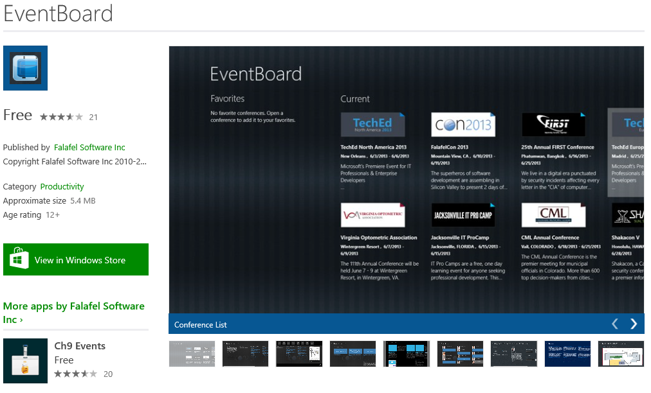
http://www.eventboardmobile.com/download

Slide 3
Platinum Sponsors
Gold Sponsors
Silver Sponsors

Slide 4
History of C++/CLI
Visual Studio .NET (2002)
Managed Extensions for C++ introduced
Visual Studio 2005
C++/CLI introduced as the successor to Managed C++
Improved syntax
Visual Studio 2010
No IntelliSense support for C++/CLI
Visual Studio 2012
IntelliSense support restored!

Slide 5
What is C++/CLI?
CLI = Common Language Infrastructure
Visual C++ with .NET extensions
Typically follows an It Just Works approach

Slide 6
What can C++/CLI Do?
Use native C++ code and code libraries
Use managed assemblies
Create mixed-mode assemblies
Contain both native and managed code
Compiled with /clr
Create purely managed assemblies
Contains only managed (verifiably type-safe) code
MSIL
Compiled with /clr:pure

Slide 7
Why use C++/CLI?
Simplicity and maintainability
No need to generate or regenerate COM interops
No need to register COM libraries
No need to manually define or update P/Invoke calls
Can use native and managed libraries from native and managed code
Can convert native code to managed code (or vice-versa) gradually
Reliability
Compile-time feedback

Slide 8
Creating a New C++/CLI Project

Slide 9
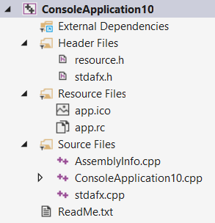
Hello, World!

Slide 10
Modifying an Existing VC++ Project

Slide 11
Basic Data Type Equivalencies
C++ | C# | C++ | C#
bool | bool
[signed] char | sbyte | unsigned char | byte
[signed] short | short | unsigned short | ushort
[signed] int / long | int | unsigned int / long | uint
[signed] long long | long | unsigned long long | ulong
float | float | double | double
wchar_t | char

Slide 12
Syntax Summary
Syntax for native items is unchanged
Many items have no distinction of native vs. managed
Namespaces
Declaring local variables and class members*
*Except for managed pointers or references
Assignment
Mathematical and Logical Operators
Using template/generic types
Accessing Members

Slide 13
Defining Types
The class and struct keywords retain their C++ meanings
Default visibility of class is private
Default visibility of struct is public
Type visibility modifiers
Default is private, equivalent to internal in C#
Can specify two visibility modifiers
“public protected” is equivalent to “internal protected” in C#

Slide 14
Defining Enumerations
“enum [class|struct]”
Equivalent to “enum” in C#
No difference between “enum class” and “enum struct”
Managed enums are also exposed as native enums

Slide 15
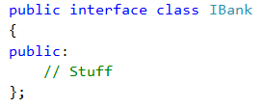
Defining Interfaces
“interface [class|struct]”
Equivalent to “class” in C#
No difference between “interface class” and “interface struct” from a managed perspective

Slide 16
Defining Value Types
“value [class|struct]” is used to define value types
Equivalent to “struct” in C#
No difference between “value class” and “value struct” from a managed perspective

Slide 17
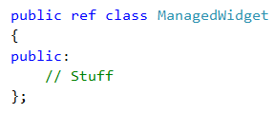
Defining Reference Types
“ref [class|struct]” is used to define reference types
Equivalent to “class” in C#
No difference between “ref class” and “ref struct” from a managed perspective

Slide 18
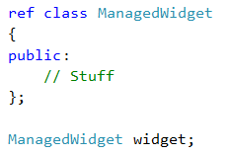
Using Managed Types
Variables and fields are declared and used the same way

Slide 19
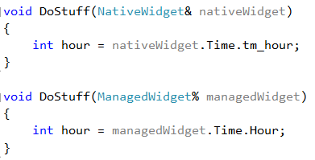
Managed References
Declaring reference uses “%” instead of “&”
Equivalent to “ref [className]” in C#
No concept of const references

Slide 20
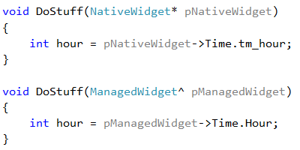
Managed Pointers
Declaring pointers to managed objects uses “^” instead of “*”

Slide 21
Memory Details
Stack semantics for reference types
Automatically call Dispose
Still actually allocated on the managed heap
Restrictions
Native objects containing managed state
Managed objects containing native state

Slide 22
IDisposable and Destructors
IDisposable is implicitly implemented when a managed class has a destructor
Used to dispose any managed resources
ManagedClass::~ManagedClass() { }

Slide 23
Finalizers
Used to clean up native resources
ManagedClass::!ManagedClass() { }

Slide 24
Marshalling
Conversion from managed to unmanaged type
std::string to System::String^, for example
http://msdn.microsoft.com/en-us/library/vstudio/bb384865.aspx

Slide 25
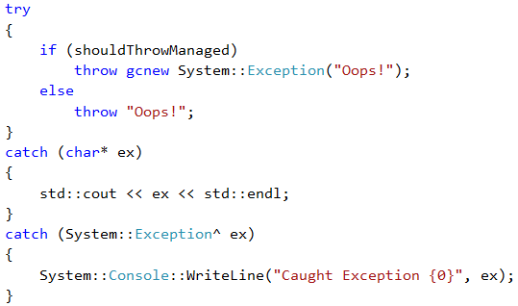
Exception Handling
Very similar to C++ exception handling
Can also catch managed exceptions
All inherit from System::Exception

Slide 26
Code Documentation
Same as C#
Must enable the /doc compiler option

Slide 27
Limitations
Cannot create AnyCPU mixed-mode assemblies
Can create pure MSIL assemblies using /clr:safe
Cannot create static libs
Header files referenced by native projects must not contain any managed components
That includes forward-declarations of managed types

